Slide 1
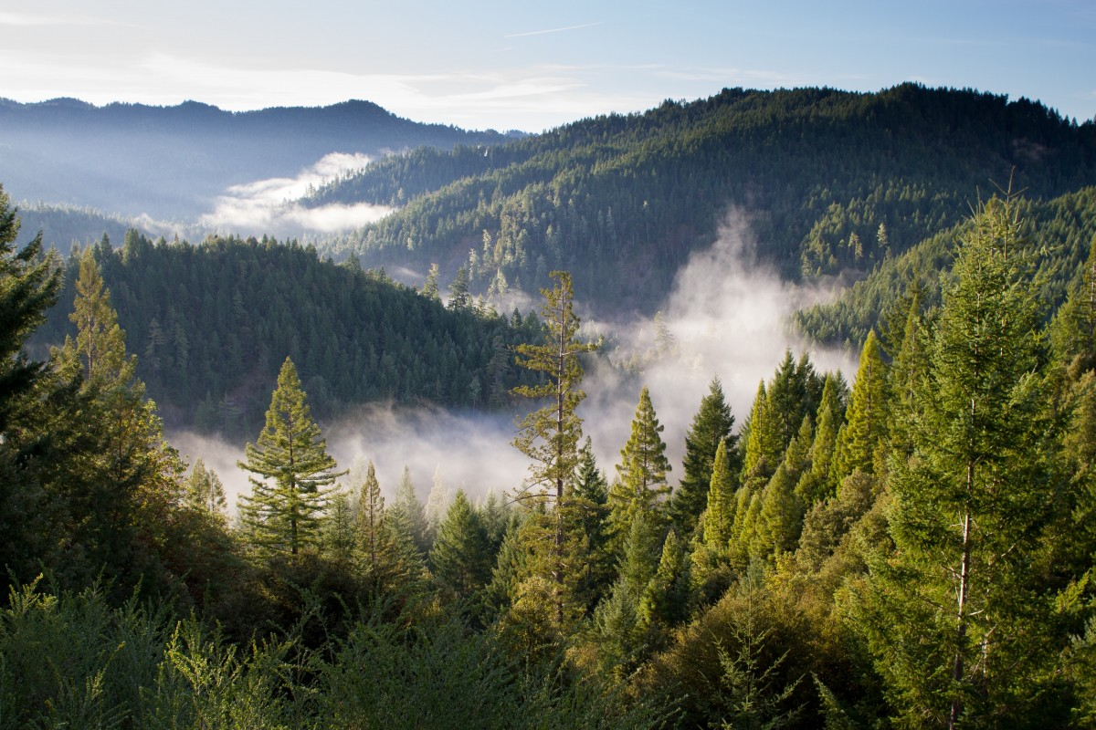
UTTARAKHAND TOURISM
SUBMITTED BY:-
Prachi Pant

Slide 2
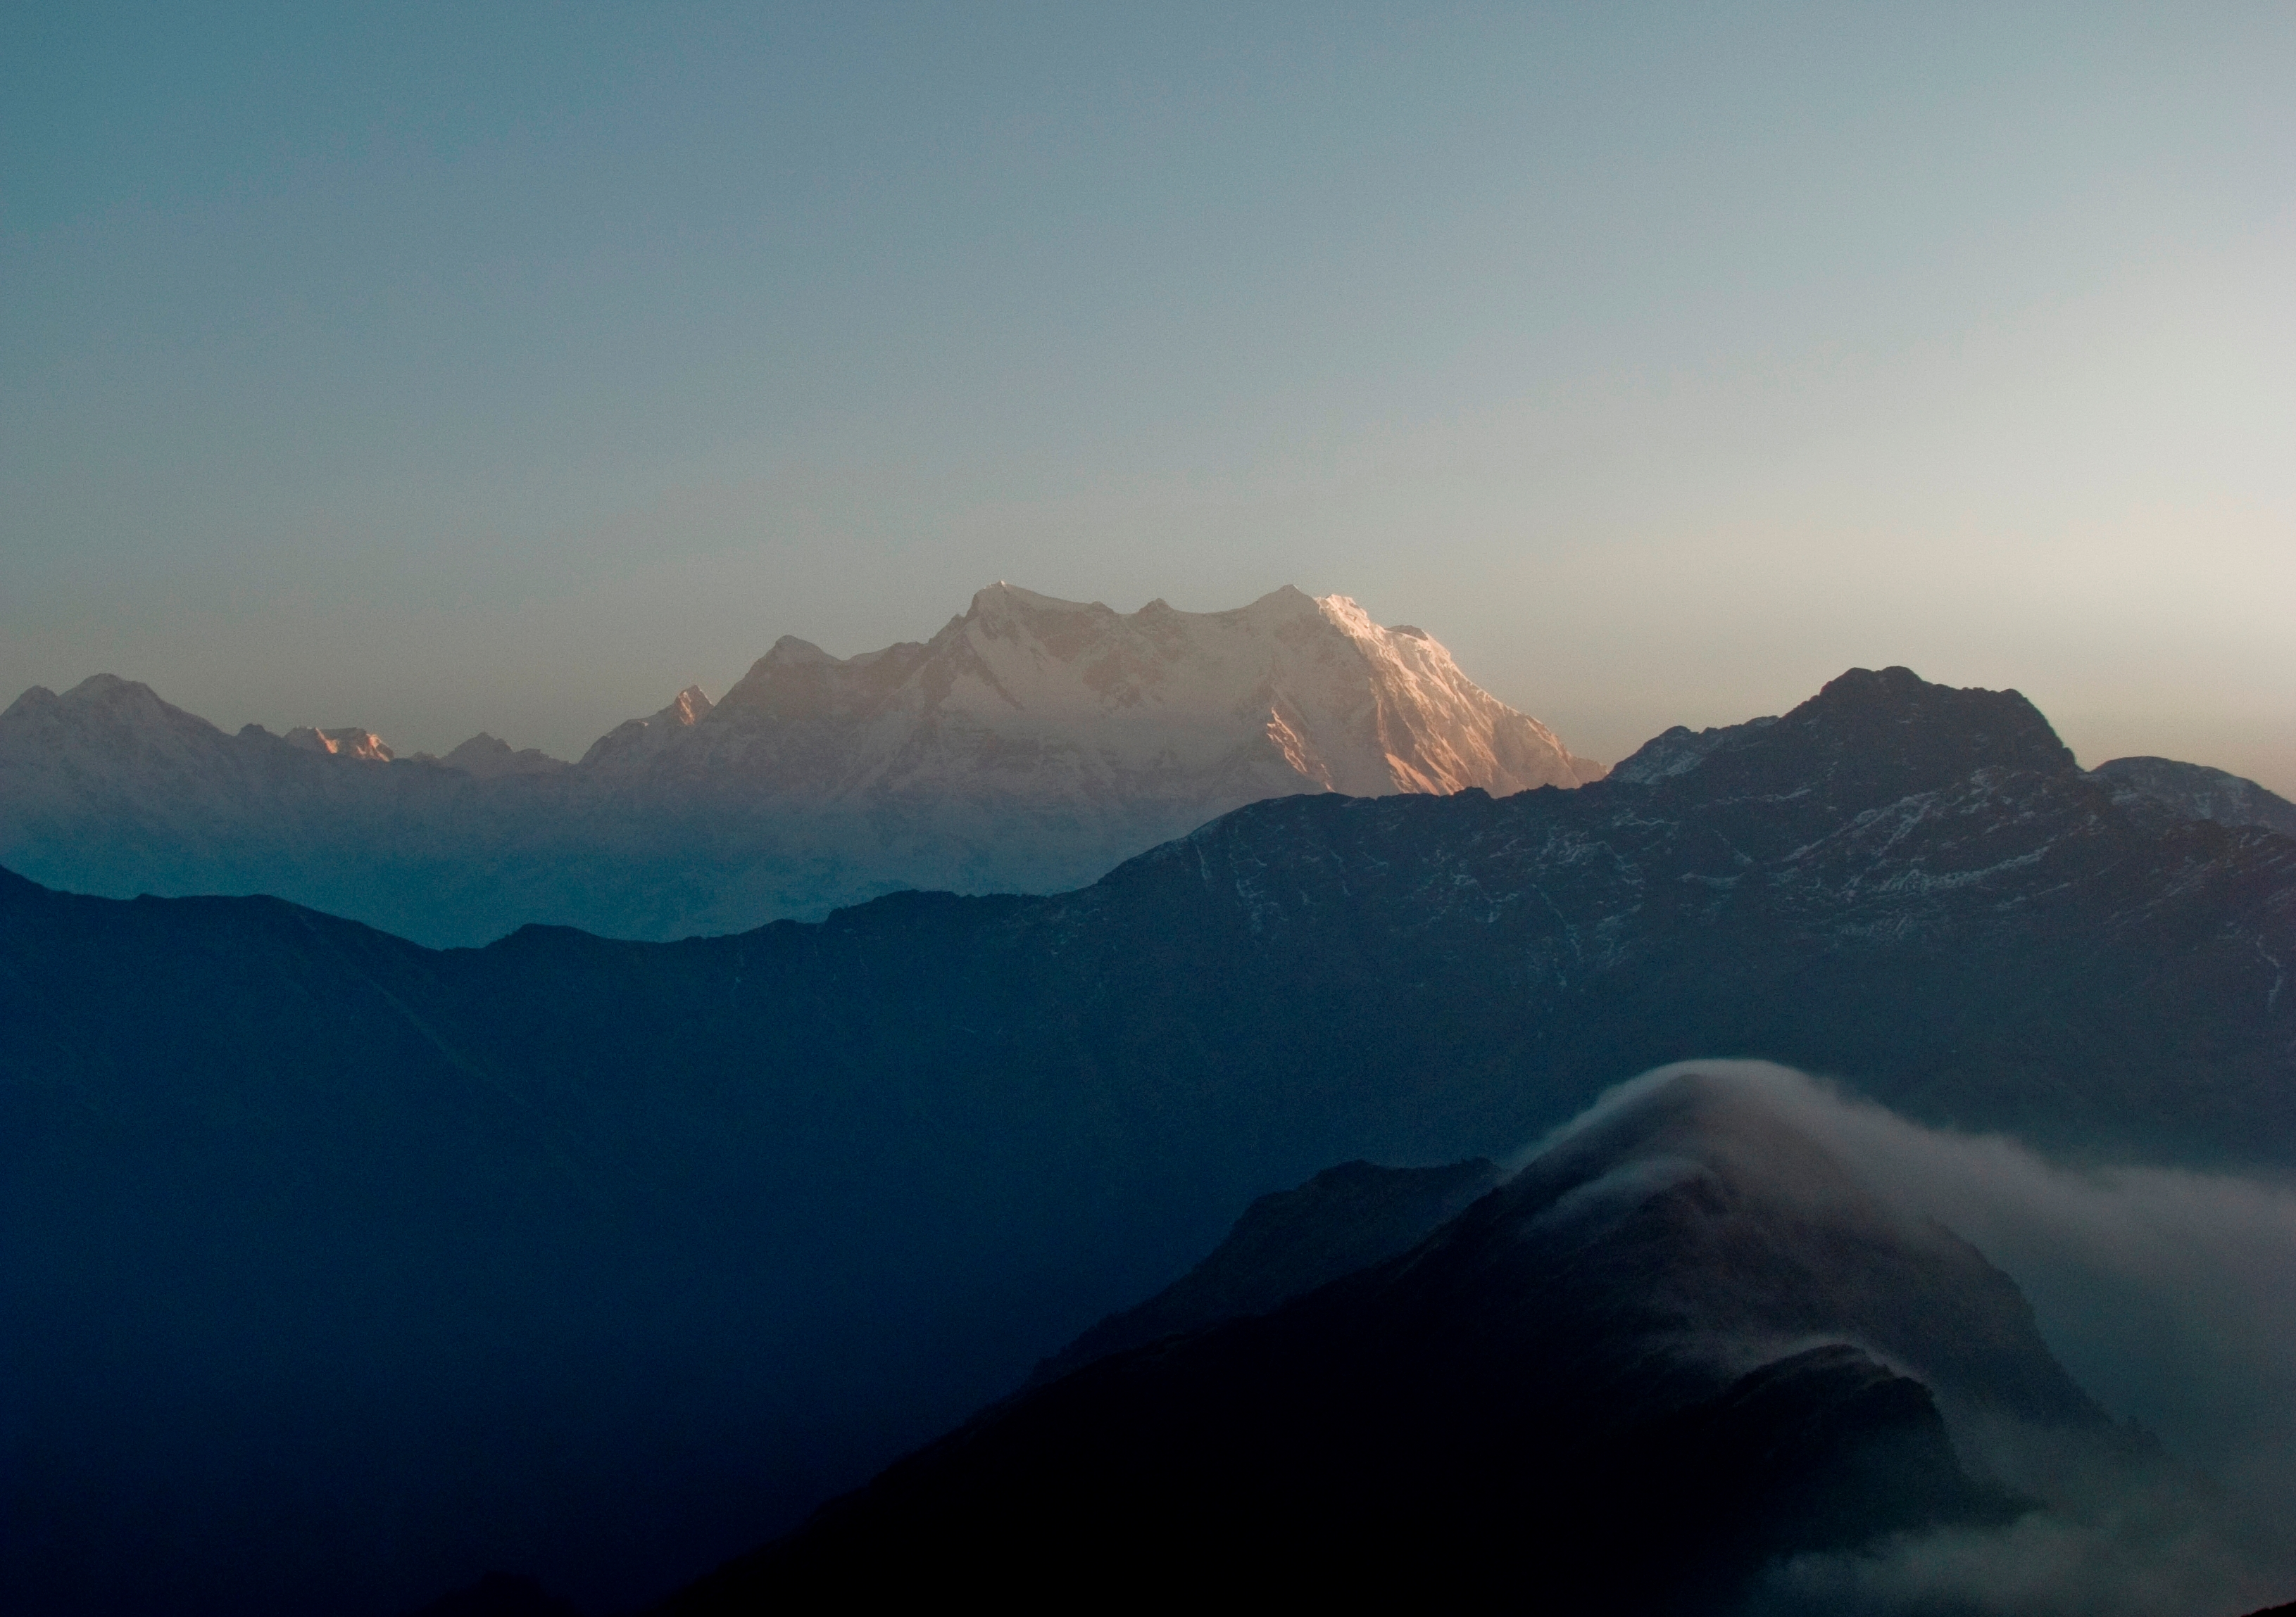
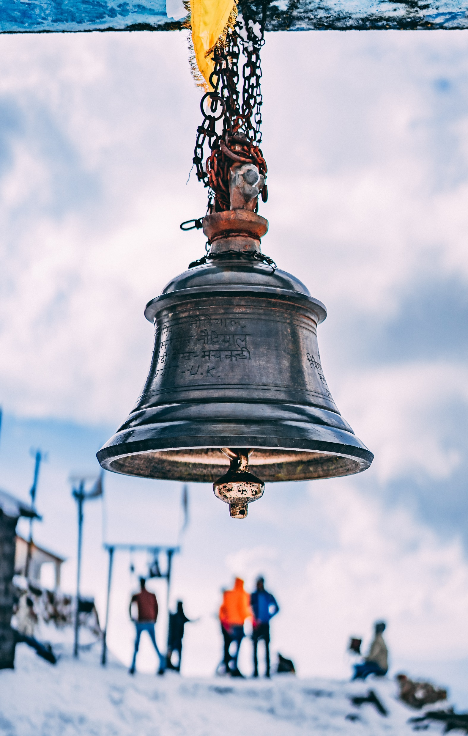
INTRODUCTION OF UTTARAKHAND TOURISM
A land of myths and mountains, Devbhoomi Uttarakhand, It is one of the most beautiful states of India. Snow-capped Himalayan peaks, serpentine rivers, revered temples,
quaint villages, vibrant culture, and World Heritage Sites, Uttarakhand's sheer natural beauty and diversity beckon travelers from across the world.

Slide 3
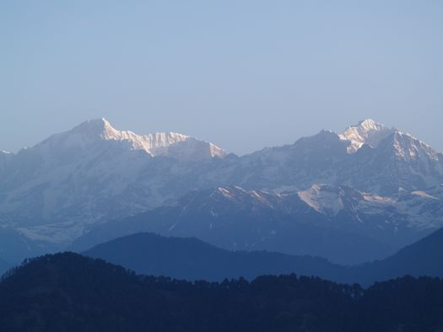
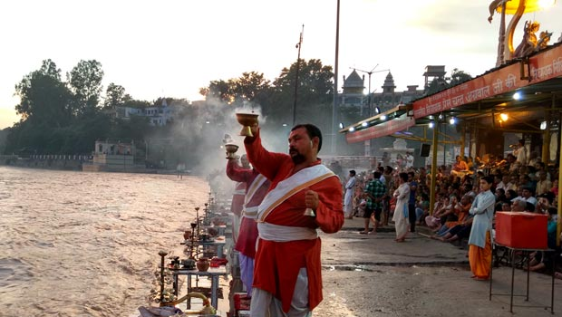
Cultural Heritage
Uttarakhand is renowned for having exquisite Kumaoni
andGarhwali cultures.
What clearly distinguishes them are the diverse customs, faiths, fairs, festivals,
folk dances, and music.
Garhwali, which also contains a number of dialects such as Jaunsari, Marchi, Jadhi, and
Sailani, is the main language spoken here

Slide 4
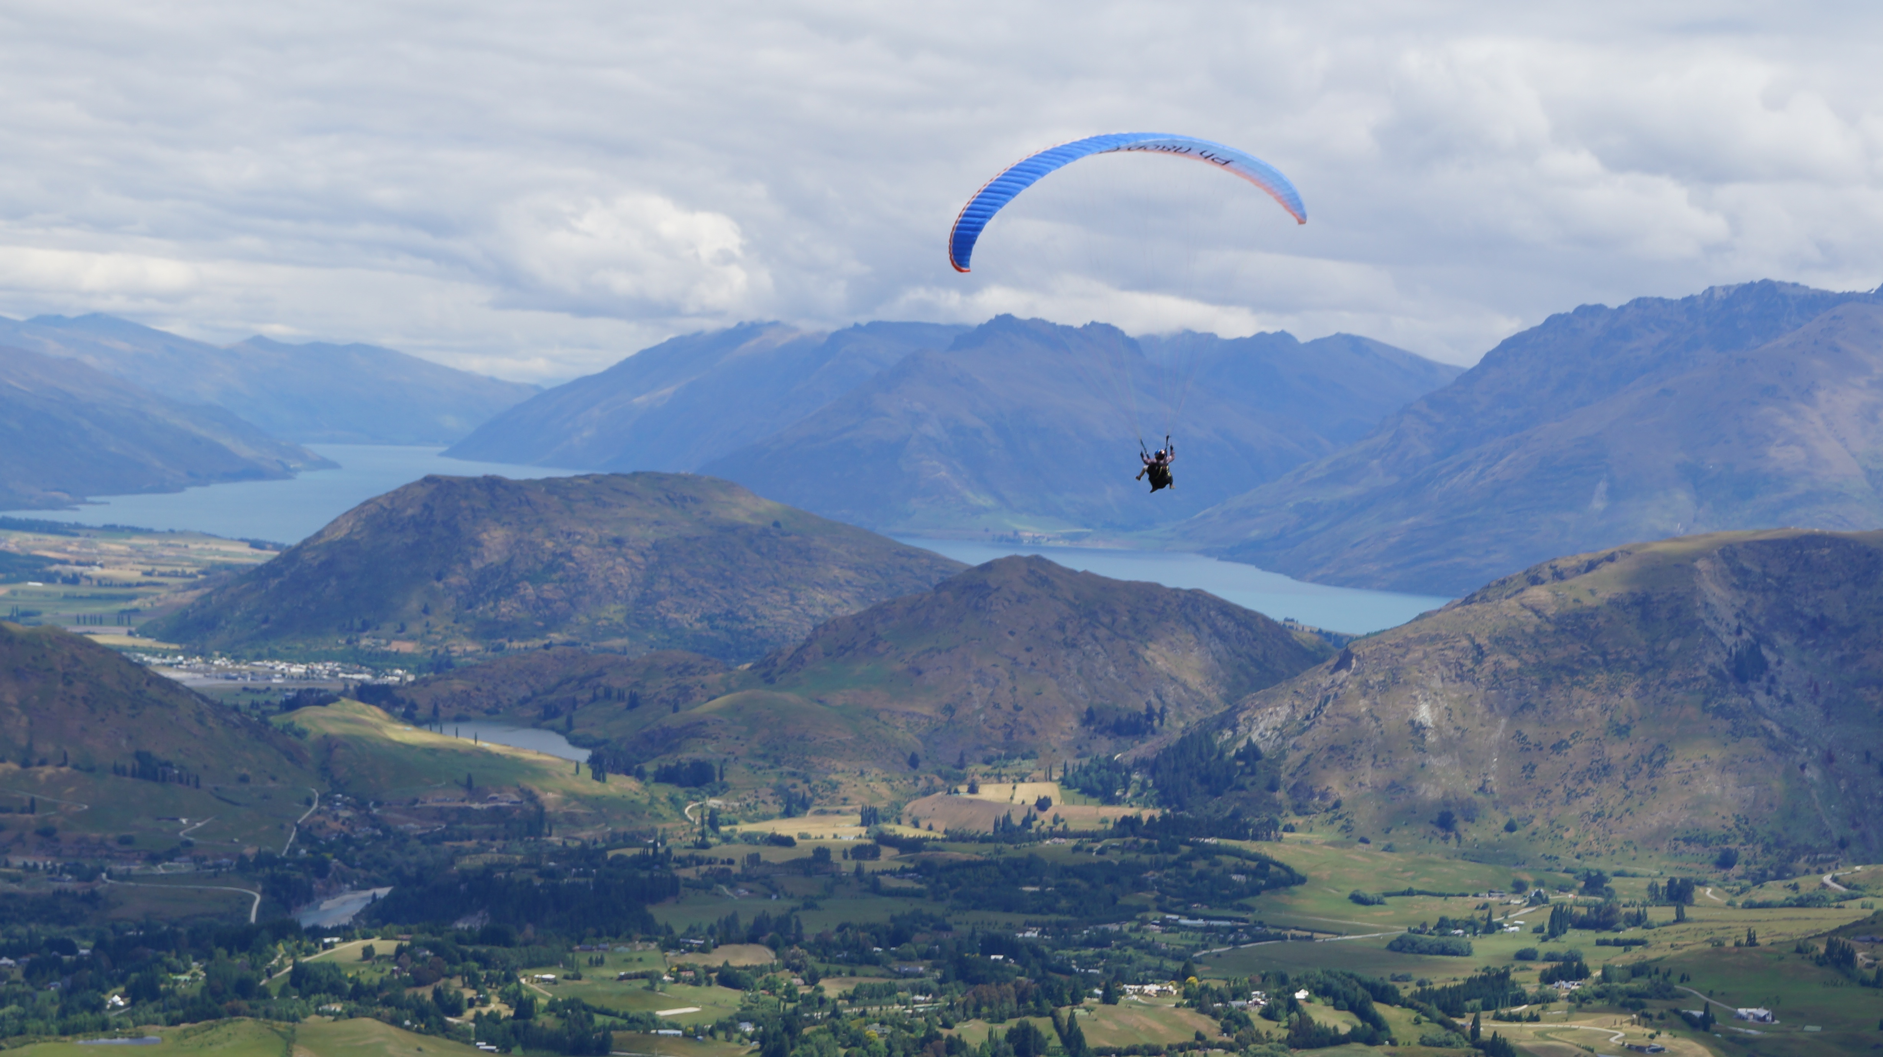
Extreme Outdoor Adventure Sports
White Water Rafting
River rafting is among the best adventure sports in Uttarakhand. Perhaps it is one of the most sought-after adventure water sports done by almost every adventure freak during a trip to Uttarakhand.
Tandem Paragliding in Mussoorie
It is fascinating to fly high in the air and enjoy the aerial view from above as you do while paragliding. Tandem Paragliding at Mussoorie is one of the best ways to do so.
Bungee Jumping in Rishikesh
The best way to overcome your fear is to indulge in Bungee Jumping. It is one of the most thrilling adventure sports that can be ventured in Uttarakhand. Mohan Chatti in Rishikesh is a place, which is also renowned as India’s first fixed platform for bungee jumping. No doubt, it is one of the best places to enjoy this adrenaline-rushing sport.
Snow Skiing in Auli
Witness the magnificent views of the stunning mountain range of the Himalayas while getting excited about the slopes of Auli.

Slide 5
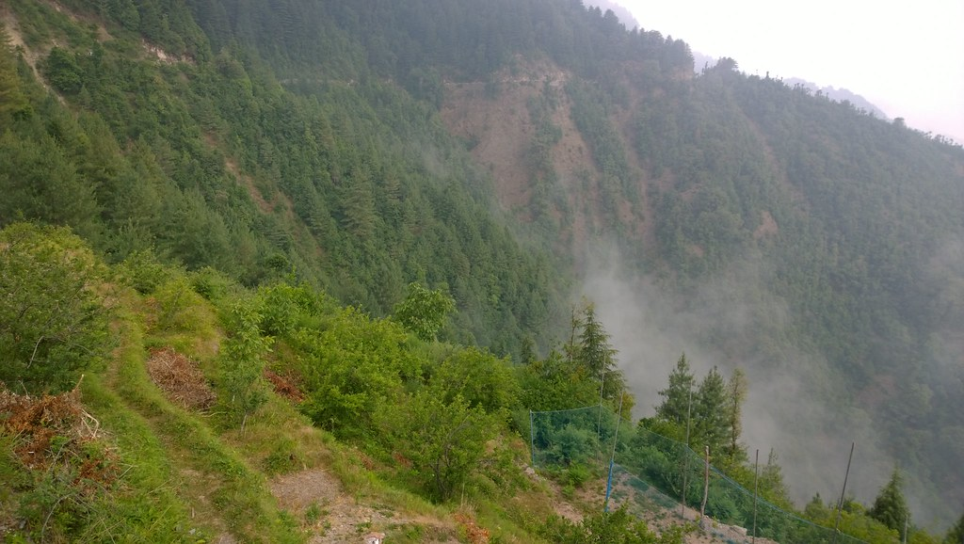
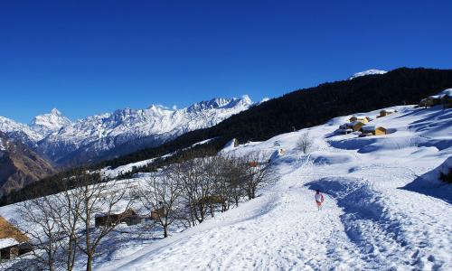
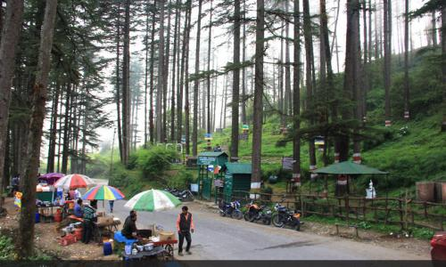
HILL STATION
Mussoorie:- also known as the Queen of Hills, is one of the most popular
hill stations in the country. This tourist destination, located 35 km from Dehradun,
is known for its beautiful views of the Himalayan ranges.
Dhanaulti:- about 35 km from Mussoorie, is a hill station in the Tehri Garhwal district of Uttarakhand. It is situated in the Himalayan mountain range at an altitude of about 2,250 meters above sea level.
Auli:- is a hill station and ski Destination located in the Chamoli district of Uttarakhand. It is situated in the Himalayan mountain range at an altitude of about 2,909 meters above sea level. It is known for its snow-capped slopes.
Nainital:- Known as the "City of Lakes, Nainital is a picturesque hill station situated at an altitude of about 2,084 meters above sea level and the foothills of the Kumaon Range.
Chakrata:- is a hill station and cantonment located in the Dehradun district of Uttarakhand.
It is situated in the Himalayan mountain range at an altitude of about 2,118
meters above sea level and is known for its beautiful views and lush green forests.

Slide 6
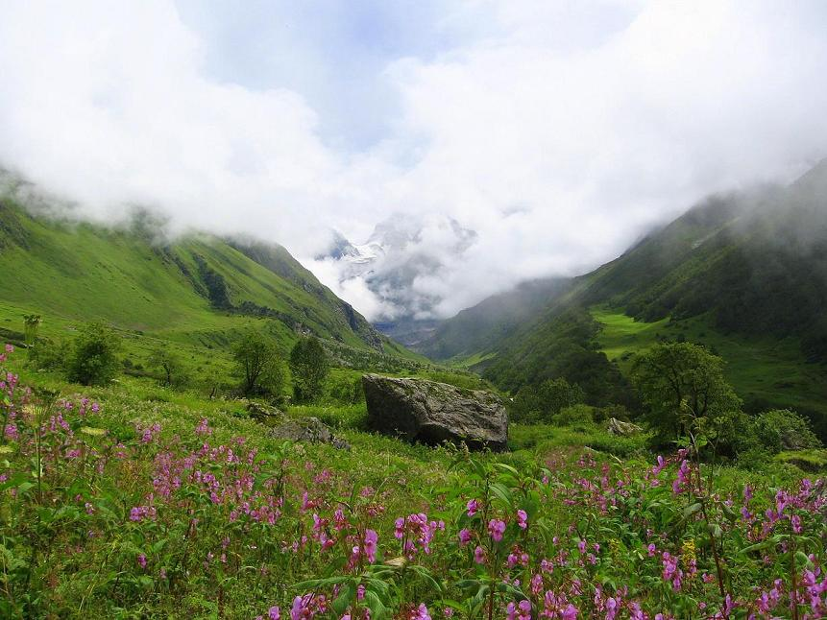
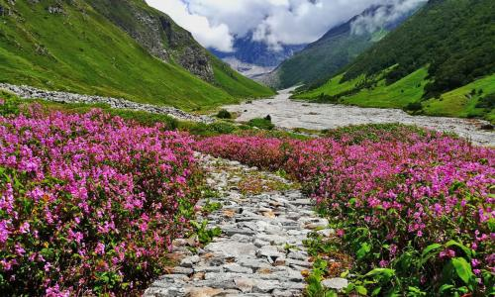
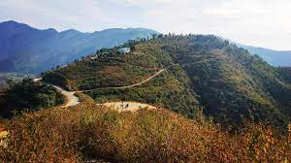
TREKKING
Har Ki Dun Trek:- Situated at a height of 3566 m in the Western Ganges of the Garhwal Himalayas, the Hanging valley of Gods, also known as Har ki Doon, is a moderate trek, offering a wonderful experience to the trekker.
Nag Tibba Trek:- the ‘Mountain of the Serpent’, placed in the lesser Himalayan region is a wonderful experience for adventure seekers. The locals believe that this range is an abode of the Nag Devta, who is worshiped by them as a deity. The trek is also known for offering memorable sunrise and sunset views.
Valley of Flowers Trek:- the Valley of Flowers trek is a heaven for nature lovers as well as photographers. Considered one of the best places for trekking in Uttarakhand in Monsoon, It has slim passages, craggy terrains, sharp climbs, and alluring views of the surrounding mountains.
Panch Kedar Trek:-Covering 5 shrines of Lord Shiva in the captivating Kedar valley, the Panch Kedar trek offers a memorable experience, away from the chaos of city life. Ideal for planning a holiday in
Uttarakhand, the trek lures both novices as well as expert trekking enthusiasts.
The trail is a wonderful mix of serenity and beautiful scenic charm.

Slide 7
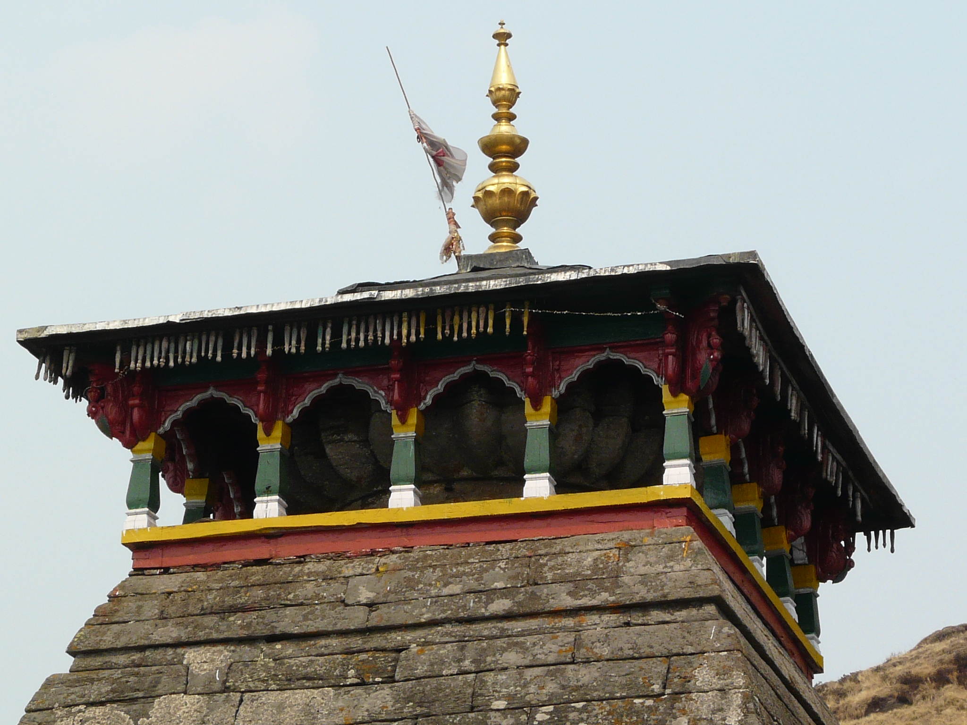
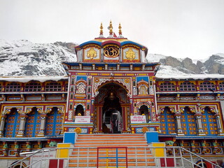
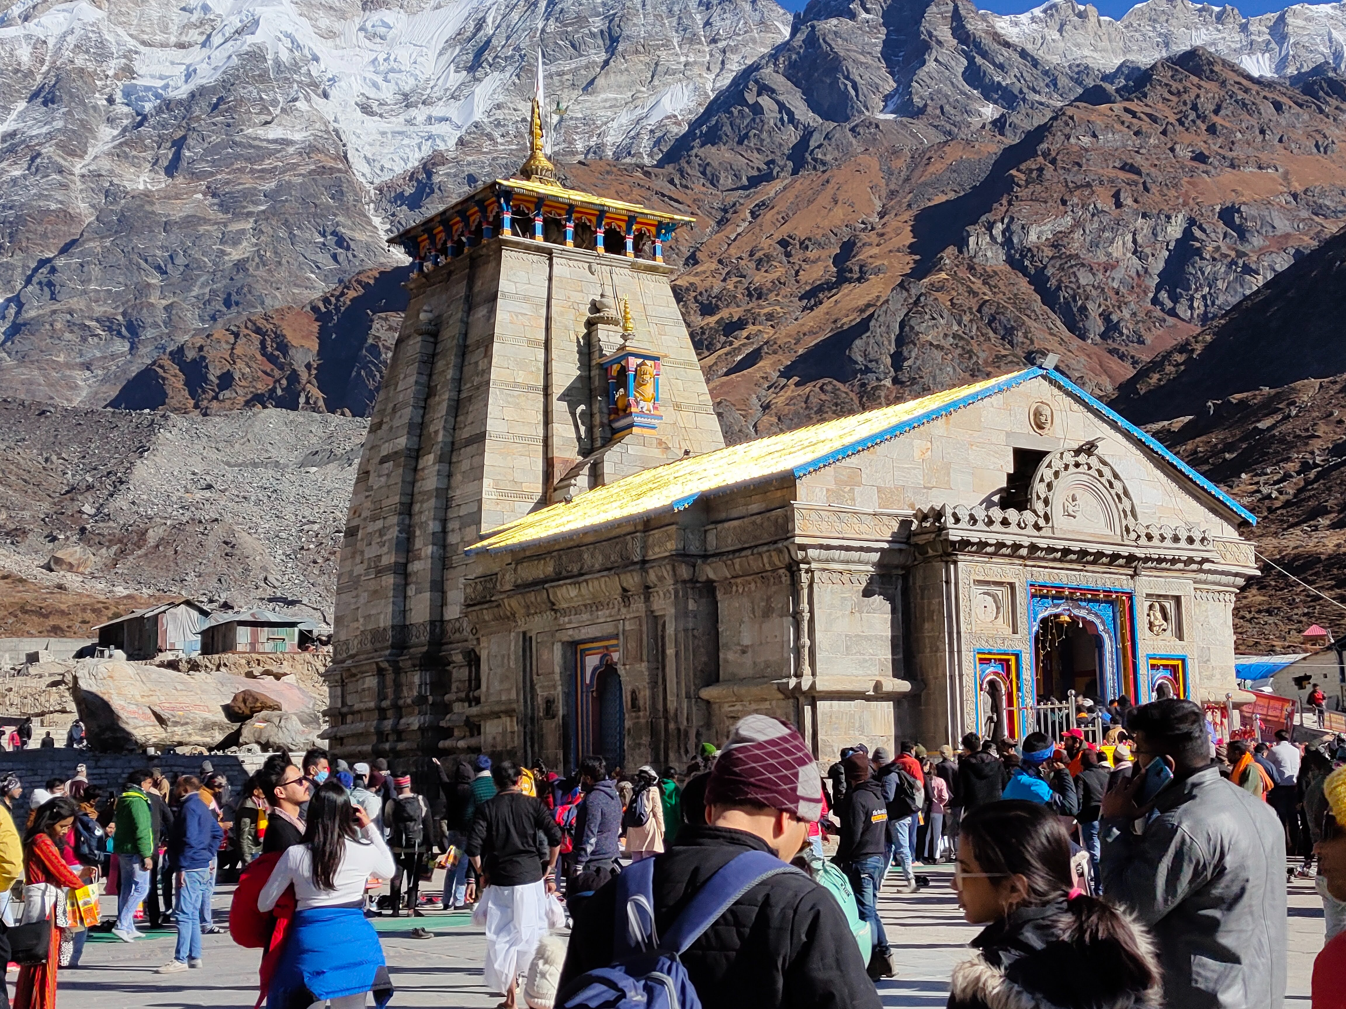
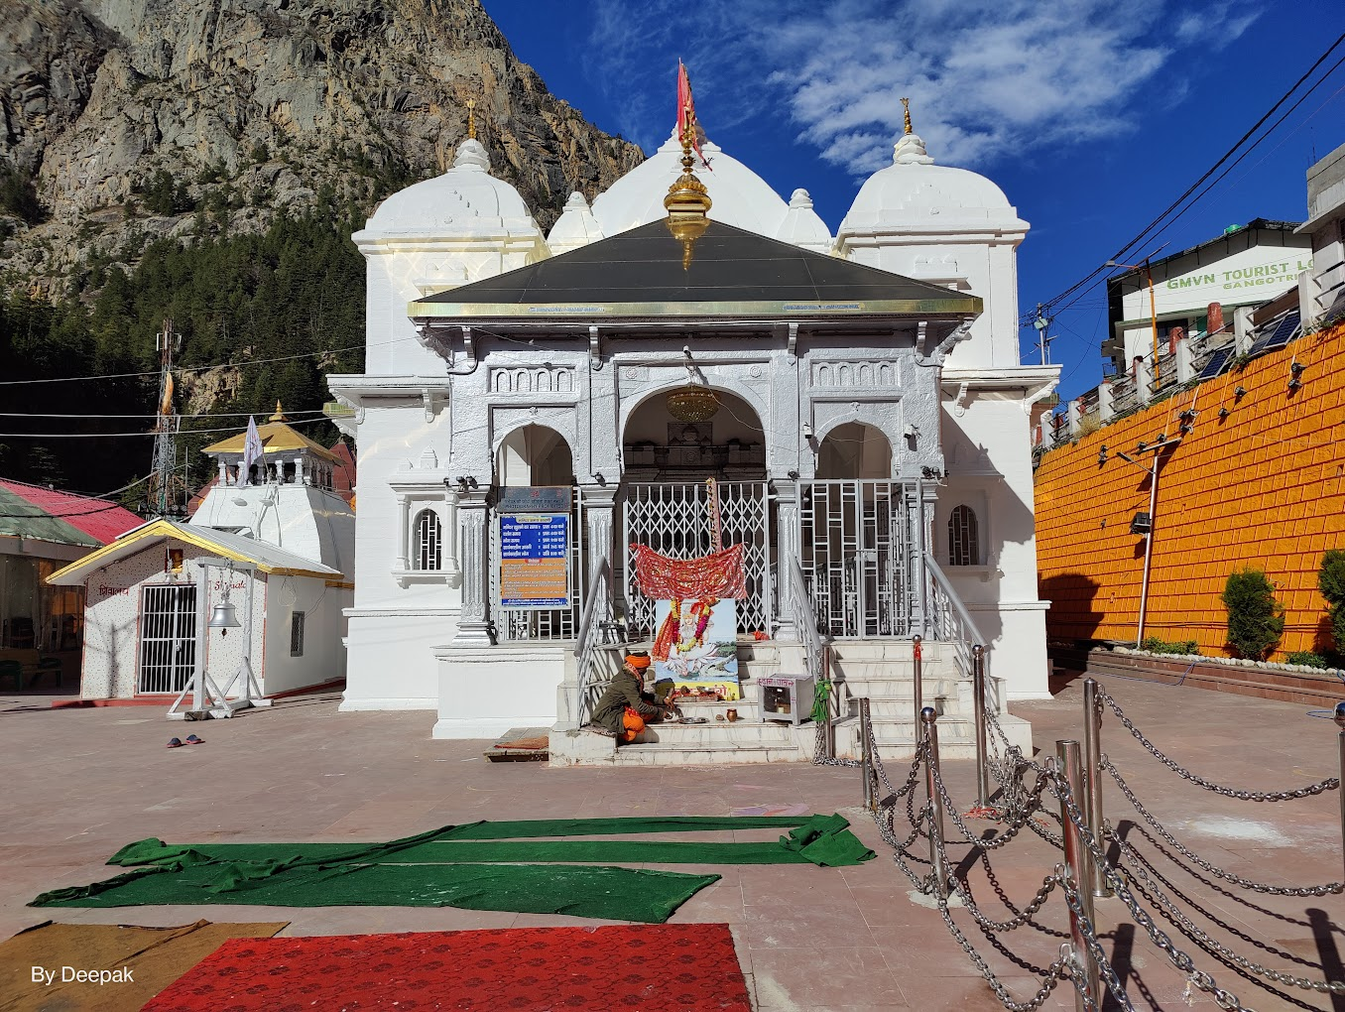
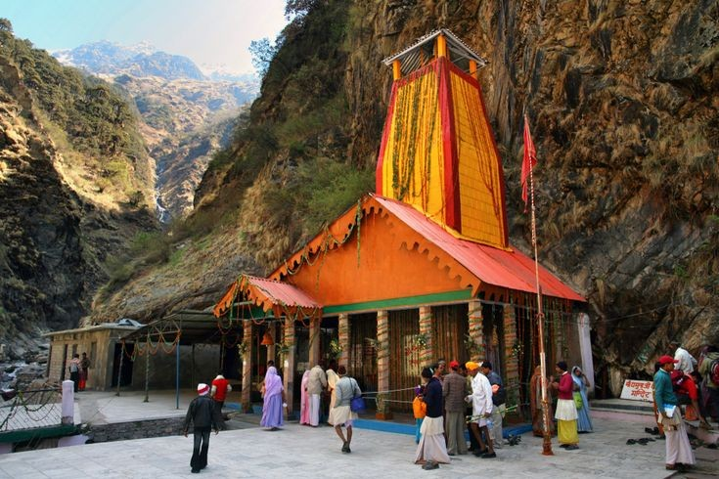
CHAR DHAM
BADRINATH DHAM:- Dedicated to Lord Vishnu, the Badrinath Temple is one of the most important pilgrimage sites in India. It is among the four holy places or char dham, which are much revered by Hindus.
KEDARNATH DHAM:- the temple was initially built by the Pandavas, and is one of the twelve Jyotirlingas, the holiest Hindu shrines of Shiva. The doors of Kedarnath are closed for pilgrims during winter, that is, November to mid-April due to bad weather conditions, and are open in summer.. The Pandavas were supposed to have pleased Shiva by doing penance in Kedarnath.
YAMUNOTRI :-The sacred shrine of Yamunotri, source of the river Yamuna, is the westernmost shrine in the Garhwal Himalayas, perched atop a flank of Bandar Poonch Parvat.
GANGOTRI :-It is the highest temple dedicated to Goddess Ganga. The holy River Ganges originates from the Gangotri glacier, located here, and is called Bhagirathi.

Slide 8
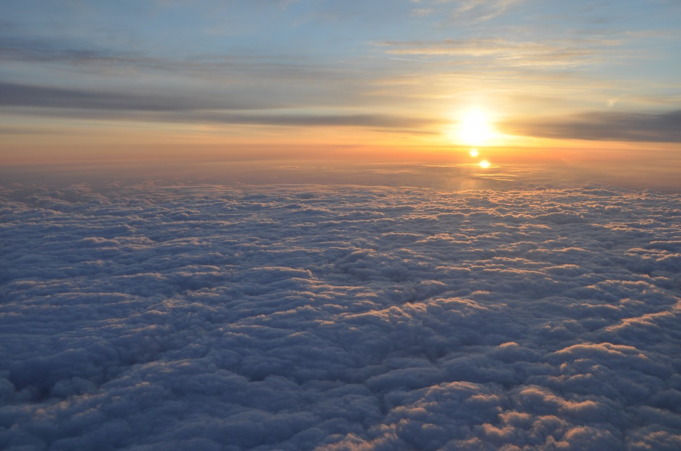


TECHNOLOGY USED

Slide 9
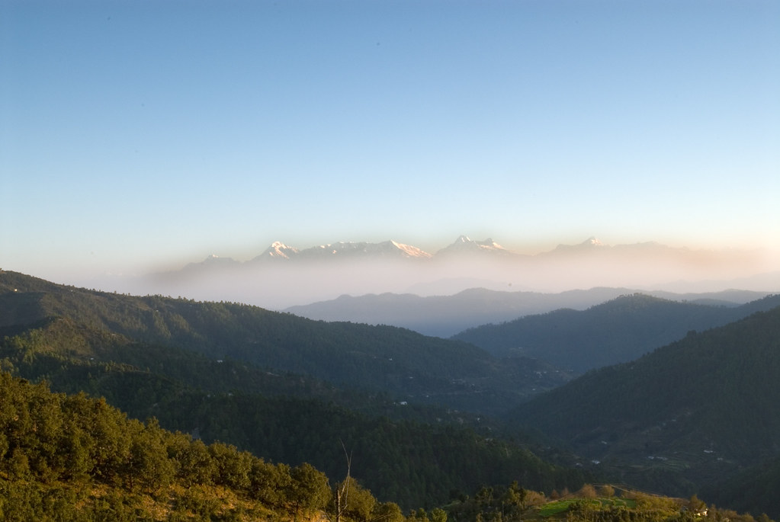
CONCLUSION….
In conclusion, Uttarakhand remains a captivating destination that caters to a diverse range of interests, from spirituality and culture to adventure and nature. The sustainable development and responsible tourism practices will play a crucial role in ensuring the long-term prosperity of Uttarakhand's tourism industry. It's advisable for travelers to stay updated on the latest information and guidelines while exploring this beautiful state.

